Slide 1
UX in the Real World
Scarlett Sidwell

Slide 2
UX Agenda
What is it?
Why do we care?
How do we convince other people to care?

Slide 3
What is UX?

Slide 4
User
eXperience
“User experience” encompasses all aspects of the end-user’s interaction with the company, its services, and its products.
-- Nielsen Norman Group

Slide 5
Field Studies
Focus Groups
Remote Usability Studies
Card Sorting
Eye Tracking
Surveys
Interviews
Ethnographic Field Studies
Help Desk
Participatory Design
Email Surveys
User Observations
Customer Feedback
Wireframing
Web Analytics
A/B Testing
Intercept Surveys

Slide 6
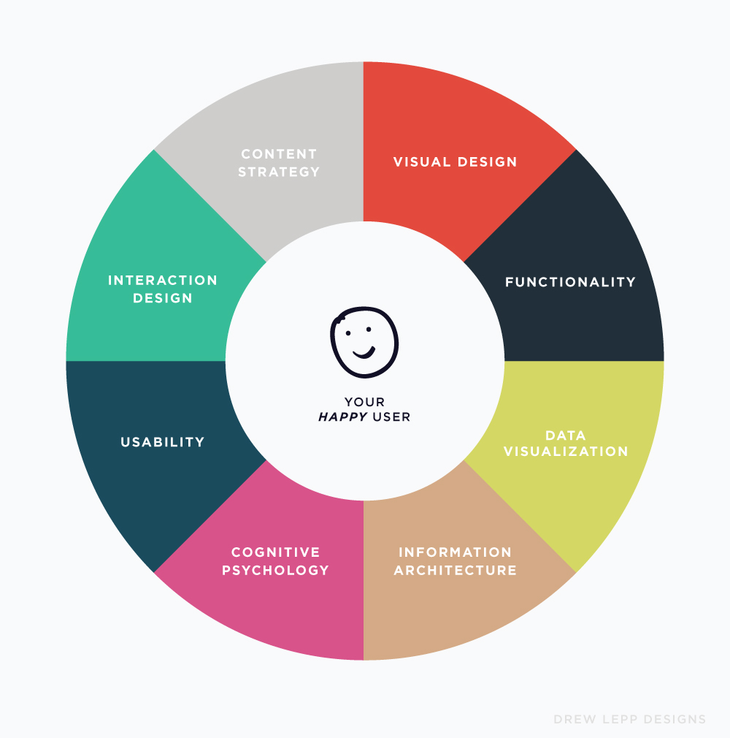

Slide 7
Why is UX important?

Slide 8
Humanity
Don’t cause harm to our users
Don’t cause the user stress or agitation when using our application
Enjoy our application
Recommend our application to other users

Slide 9
$$
10% investment yields an average of 135% metric increase*
Increased employee productivity
Fewer calls to call centers
Increased site traffic
Higher conversion rates
Customer Experience leaders regularly outperform competition by 26 points on the S&P Index*
*Nielsen Norman Group

Slide 10
How do we prove value with UX?

Slide 11
Interviews
Conducting interviews with external customers before implementing new functionality based on user complaints.

Slide 12
Best Guess vs. UX Study
1 hour for finding all instances of the “Expected Delivery Date” across the entire site.
3 days for implementing date editing across the system
4 hours for input validation on the “Create Order” page
5 minutes for talking with end user
1 hour for implementing data editing in specified locations
15 minutes for updating the “Create Order” page
5 minutes for confirming the issue had been resolved for end user
= 29 hours
~1.5 hours

Slide 13
Card Sorting
Determine the most effective navigation for the majority of users.

Slide 14
Cost vs. Reward
1 hour prep for field study
2 hours of field study
1 hour in results analysis
$200 for lunch
Reduced call volume to HR by nearly 75%, because employees could find information, online
Employee productivity increased, due to decreased amount of time searching for information
HR employees productivity increased, due to less time on the phone
Discussions about a potential HR call center abandoned after 3 months of new system

Slide 15
User Observation
Validate concerns, and find where users are struggling the most within a data entry system.

Slide 16
Cost vs. Time
$150,000 for Phase 1
$100,000 spent by users to attend training activities
$100,000 for Phase 2
2 employees * 2 hours to perform user observations
5 employees * 1 hour to review results
= $350,000
9 hours

Slide 17
Help Desk
Use the resources that are established and available to find user experience problems.

Slide 18
Calculating Less Reliance on Call Centers
Reduced number of calls:
(
)
(
)
# of calls to
Call Center
Per year
X
Projected %
reduction
X
Average
Length of call
X
Average Call Desk
Staff salary/minute
= Annual ROI
Example:
(
)
(
)
50,000
X
0.25
X
.07
X
$16/hr
= $14,000
( calls )
( % reduction )
(4 minutes)
$30,000/yr

Slide 19
Web Analytics
Validate business initiatives with what’s important to your users.

Slide 20
Cost vs. Users Effected
1 development team at $50,000 per week
Minimum of 6 weeks of development per problem browser
IE7 and Netscape both had compatibility issues
Analytics showed that 3 of 3000 users that logged in per day, were using IE 7.
Less than that, for Netscape
= $600,000
< .2% affected

Slide 21
The End!
Questions?

